Slide 1
Database Project
By
Abdul Wahab Asif FA16-BCS-019
M Huwaiza Tahir FA16-BCS-025
Najaf Ali FA16-BCS-158

Slide 2
Rizwan Mirza Consulting Services
Objectives:
The main objective for developing this project is to maintain all employees, assigned projects, and their clients, with managing utilities and Equipment. This system also maintains income, expenses so one can keep things organized and get detailed report of business. It allows user to keep track of customer details, projects, invoicing system is also integrated. The core focus of this project is based on the user requirements a conceptual database design is proposed and future recommendations are given.

Slide 3
Requirement Specifications
Manage Employees:
Add a new employee
View Employee’s Information
Search an Employee
Update an Employee Information
Manage Projects:
Add a new Project
Project is associated with one employee
One project can be handled by multiple employees
Project status
Manage Clients:
Administrator can manage clients information
Client association with project and employee
Add and remove client

Slide 4
Requirement Specifications (Conti)
Manage Utilities:
Like Show bill
Add bill
Remove bills
Billing information for Gas, electricity, internet, water etc.
Invoicing System:
Invoice will be generated for each order from client. This invoice will show some information of project and project fees.
Project History:
Project history will show user, total number of projects assigned within a given time period.

Slide 5
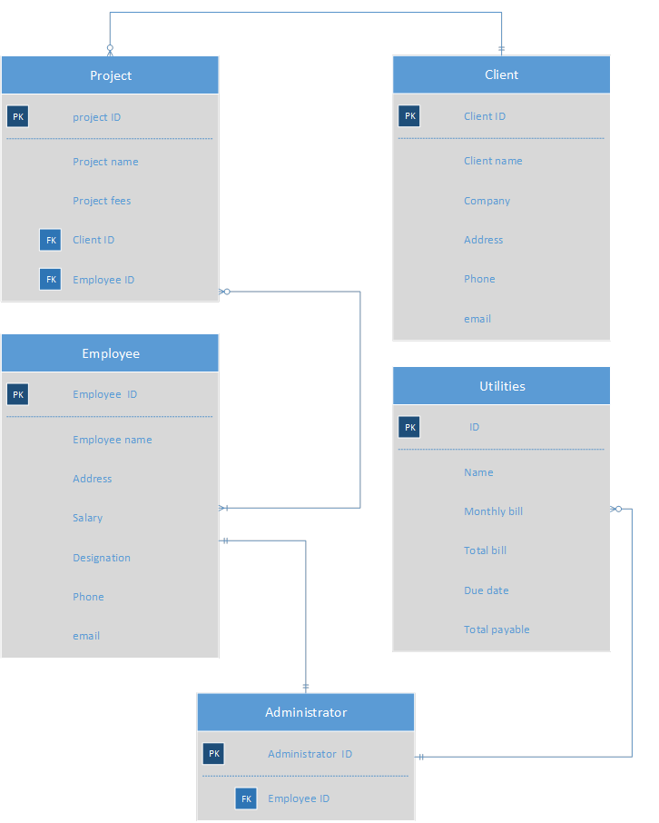
Entity Relationship Diagram

Slide 6
Relationships
A Company can have none or multiple customers.
A Company must have at least one department.
Many employees can be working on many projects
Projects can have many to many relationship with clients and also employees
One client can give multiple projects
Each employee must belong to one and only one department.
One employee can receive none or many projects from customer.

Slide 7


Slide 8
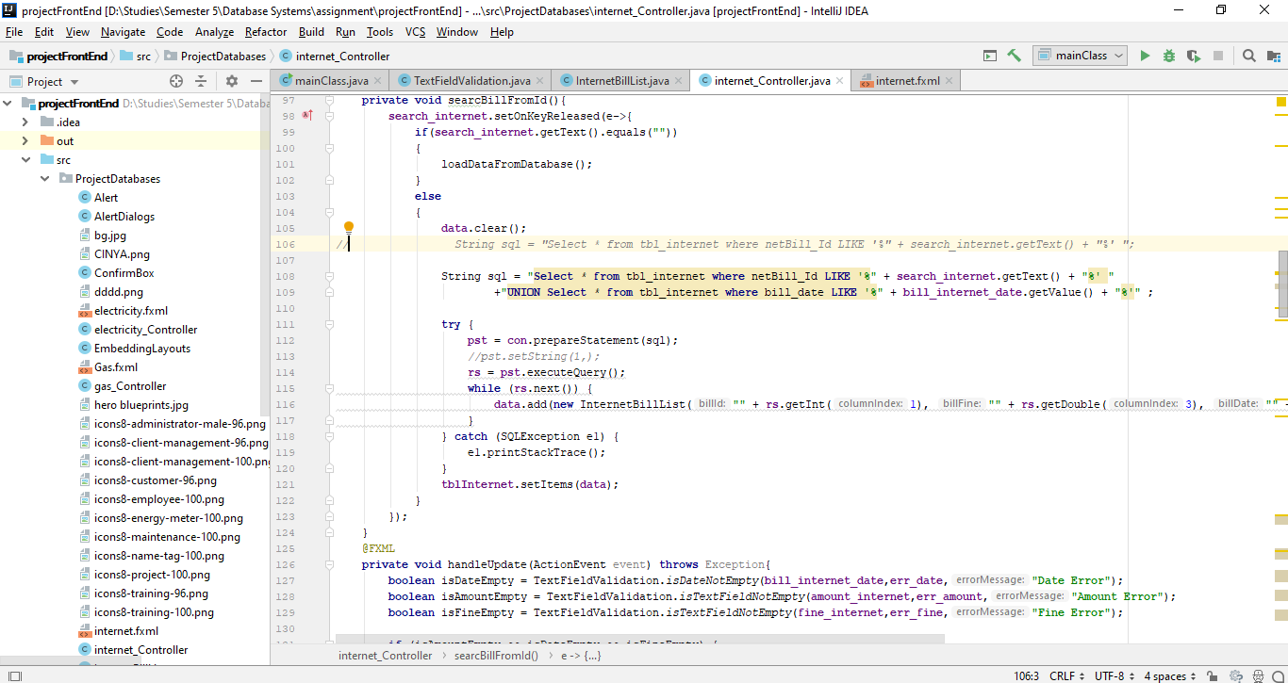

Slide 9
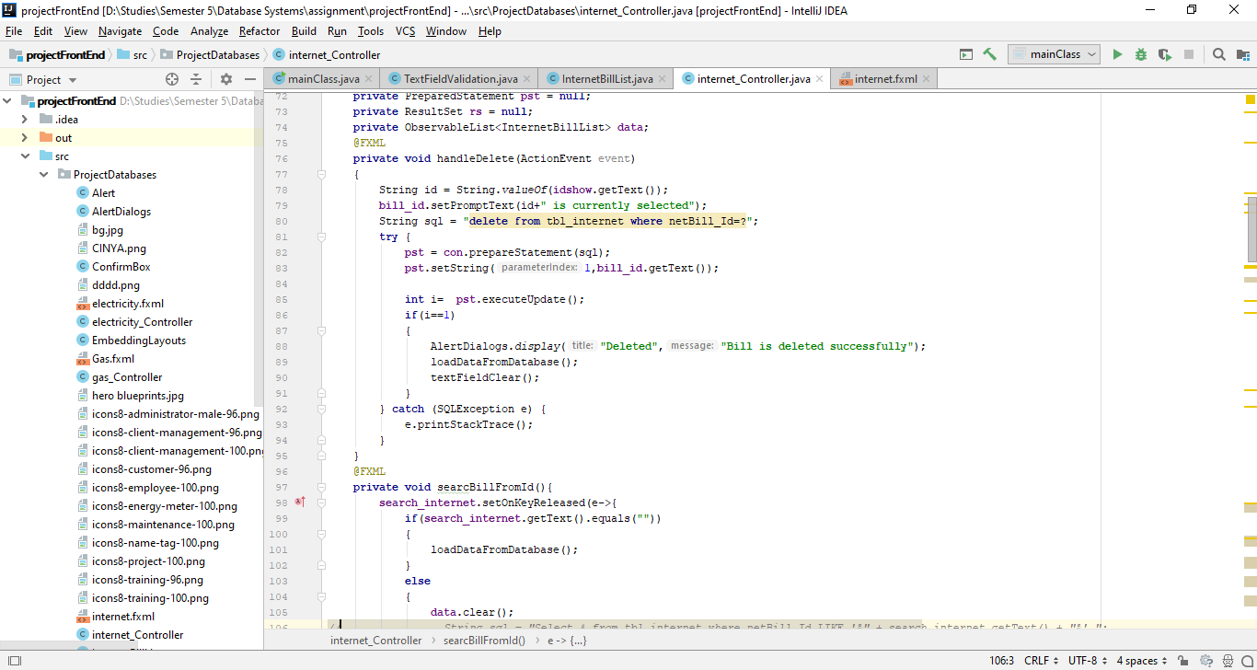

Slide 10
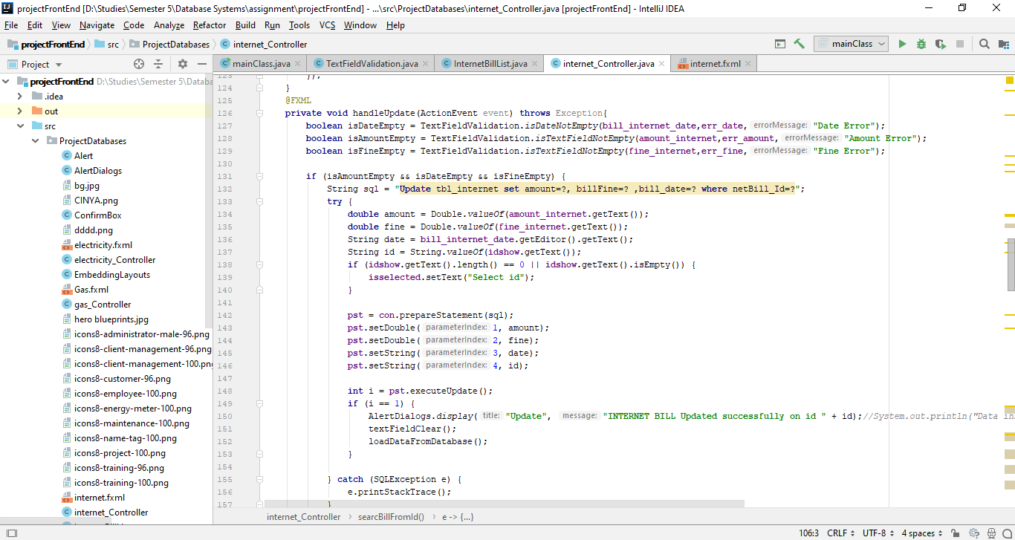

Slide 11
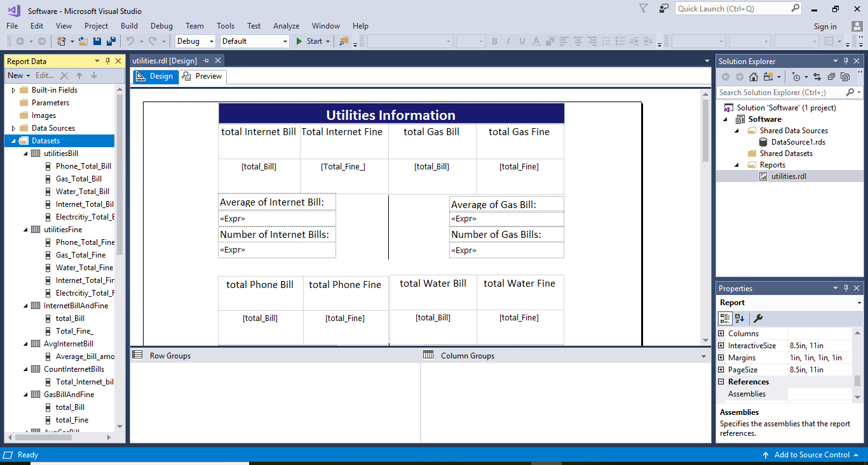

Slide 12
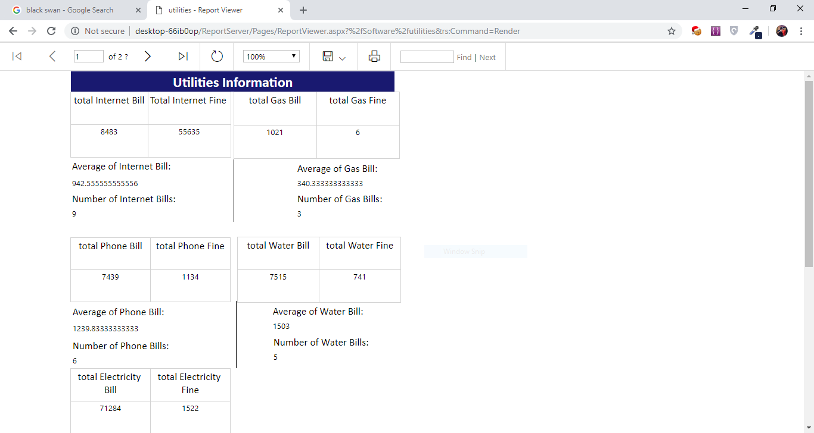

Slide 13
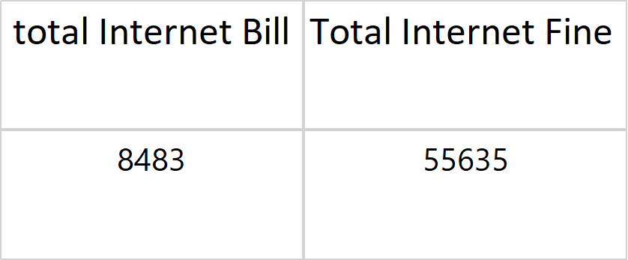
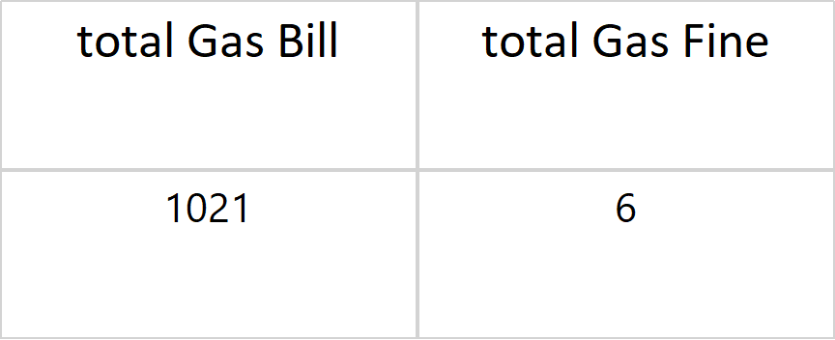
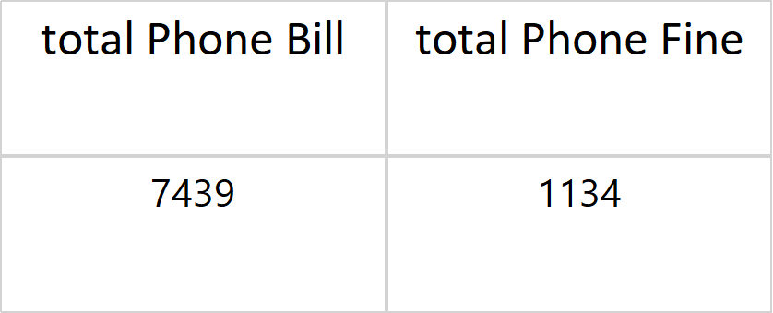
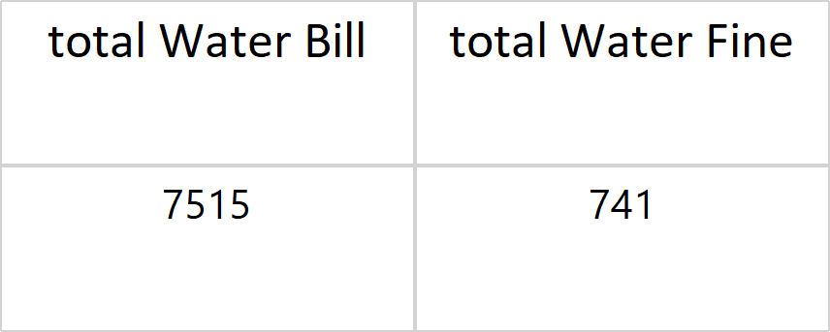
Utilities Information
Average of Internet Bill:
Average of Gas Bill:
942.555555555556
340.333333333333
Number of Internet Bills:
Number of Gas Bills:
9
3
Average of Phone Bill:
Average of Water Bill:
1239.83333333333
1503
Number of Phone Bills:
Number of Water Bills:
6
5

Slide 14
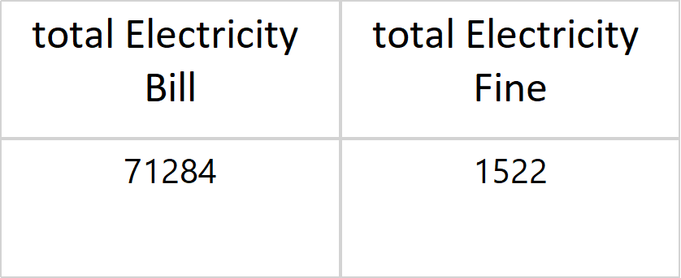
Average of Electricity Bill:
11880.6666666667
Number of Electricity Bills:
6
Bill Amounts on Same dates
total Internet Bill
total Gas Bill
total Water Bill
total Electricity Bill
1600
888
6666
11198
total Phone Bill
888

Slide 15
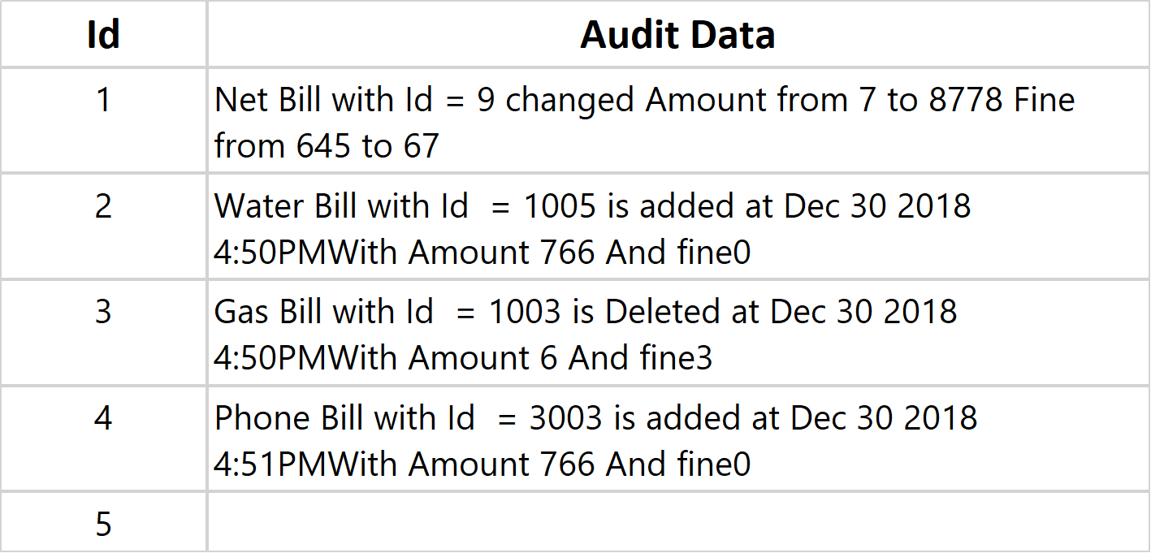
Bill Fines on Same dates
Total Internet Fine
total Gas Fine
total Water Fine
total Electricity Fine
6
8
666
561
total Phone Fine
8
Audits on All bills

